Slide 1

BOOK MY BUS
Presented By:
HARSH KAUSHIK (2100681530022)
VINAYAK CHAUHAN (2100681530059)
Under the Guidance of:
AJAY SHAH
Department of Computer Science & Engineering (AIML)
Meerut Institute of Engineering & Technology, Meerut (U.P.)
Notes:
₁

Slide 2

Presentation Outlines
Introduction
Research/Study Gap
Problem Statement
Objectives of the study
Methodology
DFD/Flow chart related to study
Hardware & Software to be used
References

Slide 3
Introduction
The project entitled “Bus Booking System” is an offline project for booking bus tickets. The main objective of developing this project is to book the bus tickets Online. This application will greatly simplify and speed up the booking process. The main aim of the project is to provide the bus tickets to the customers in a simple and accurate way. This project is useful for customers for reserving their tickets in simple manner. By this system customer can easily get the tickets by entering their destination and their current location.

Slide 4
Research Gap
According to Kevin (2012) Web-based Bus Reservation and Ticketing System is a generic web portal application that aids bus customers to reserve a seat in a certain bus company anytime and anywhere and variety of buses that satisfy the customer’s requirements are provided. The project, on the bus company’s side, serves as a marketing strategy and aids an efficient processing and delivery of itinerary receipts. The project used software like Adobe Photoshop for the creation of the images and Visual Studio code as a development tool, Code runner as the web server, MS office for the creation of PDF and MS Powerpoint for presentation. However, the softwares adopted in this project, has in recent times been upgraded. Therefore, Adobe Photoshop, Visual studio code and MS office are going to be used to implement this project.

Slide 5
Problem Statement
The current system being used by staff at their booking offices is a manual system that involves queuing of customers in line in order to make a purchase, a system that is generally slow and prone to errors such as human error bill calculation, physical loss of tickets and a lot of time wastage experienced in the entire process.

Slide 6
Objectives of the study
The main objective of the project is to provide bus tickets to customers for travelling from one place to another.
This project IS useful for customers for getting their tickets in simple manner.
By online booking reservation one can consume their time and ticket will be get at that moment .
The system is Intended for public, One can book their tickets by entering the page.
Earlier people used to avoid bus journey due to poor road infrastructure, lack of luxurious Buses and bus booking system, Now the Online bus booking system facilitates online bus bookings and instant payments which IS convenient for the booker as well as the facility provider.
There were long queues to book tickets that were time-consuming well as timing.
Booking tickets Via telephone was a difficult task because the telephone may be out of service or busy most of the time.
But the time has changed, There are plenty of luxurious buses available now.

Slide 7
Methodology
The system of collecting data for research project is known as research methodology.
The data may be collected for either theoretical or practical research for example management research may be strategically conceptualized along with operational planning method and change management. Information which was used for this study was carried out by oral interview.

Slide 8
Choice of Methodology
For any project to be completed, it has to go through stages called Development Life Cycles. System Development Life Cycle (SDLC) is the process of understanding how an Information System (IS) can support business needs, designing the system, building it and delivering it to users. The SDLC composes of four phases:
Planning
Analysis
Design
Implementation.

Slide 9
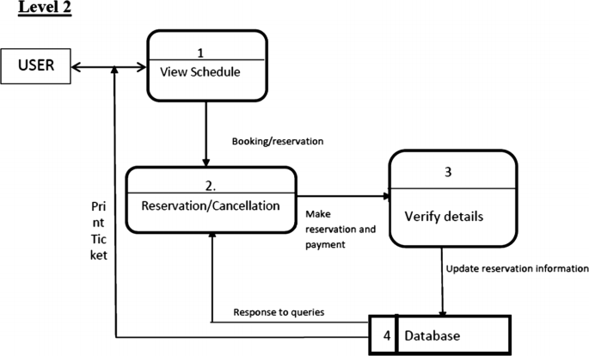
DFD/Flow chart of the study
The importance of the data flow diagram (DFD) is to show the actual happenings in the system. This is done by visualizing the system’s data management at various levels.

Slide 10
0 Level DFD for Bus Reservation System
The DFD Level 0 (context diagram) purpose is to demonstrate the project concept using a single process.
DFD Level 0 shows the entities that interact with a system and defines the border between the system and its environment. This diagram also depicts the bus reservation system at a high level.
The illustration presents the main process in a single node to introduce the project context. This context explains how the project works in just one look. The user feeds data into the system and then receives the output from it.

Slide 11
Level 1 DFD for Bus Reservation System
The “detonated view” of the context diagram is Bus Reservation System DFD Level 1. Its function is to deepen the concept derive from the context diagram.
Level 1 DFD clarifies the paths (flow) of data and its transformation from input to output
The designed diagram portrays four different scenarios. customer information management, order or reservation management, scheduling of deliveries, and transaction and payments management.

Slide 12
Level 2 DFD for Bus Reservation System
Bus Reservation System Level 2 is also the highest abstraction of the data flow diagram. This level also broadens the idea from the DFD level It includes the sub-processes from level 1 as well as the data that flows
However, not all of the processes in the project must have sub-processes. Only provide this diagram if needed. As long as your previous diagrams were clear and precise, this level is not required.

Slide 13
Hardware/Software to be used
HARDWARE REQUIREMENTS:
Processor- 11th Gen Intel Core i3 @ 2.9Ghz
RAM - 8GB
SOFTWARE REQUIREMENTS:
• Windows 11
• HTML, CSS
• VISUAL STUDIO CODE

Slide 14
References
1. Learn HTML and CSS from Envoto Tuts+ on Youtube - https://youtu.be/iG2jotQo9NI
2. Take idea of Bus Booking ideology from Zingbus - https://www.zingbus.com
3. For making a Attractive login page we use code wit random website - https://www.codewithrandom.com/2021/11/30/login-and-sign-up-form-using-only-html-css-only-codewithranom/

